Slide 1



Book Capstone User Journeys

Slide 2
MVP Life Events
Life event scope for MVP:
College
Relationships & Breakups
Divorce
Death of a loved one
Wedding of loved one (first time marriage or remarriage)
Stress (mostly school-related)
Moving
Coming of age
Adulting (assuming new responsibilities & executive functioning skills)

Slide 3


UJ #1 Colton:
Colton is about to go off to college. He’s nervous about leaving his friends and starting all over.
Colton comes to our application looking for reassurance and seeing how others dealt with the transition.
Colton searches “college” or “going to college”. He wants to find characters that look like him. He wants simple results and reads the description of the first 5 results and picks one from them.
Colton then downloads the audiobook version to listen while he skateboards.

Slide 4
UJ #1 Colton Wants:
Books that are relevant to his issue
Easy to use interface that he can scan through options quickly
Wants clear output of data to speed up choosing
Wants a description of the book so he knows if it’s about people that seem cool to him
Simple and easy to use
Wants good results immediately or will abandon the endeavor
UJ #1 Colton Does NOT Want:
Does not want lag time, frustration, or non-intuitive selections
Does not want a large list of attributes about the book.
Does not want to scroll through a long list of options

Slide 5


UJ #2 Lena:
Lena just broke up with her boyfriend Max. They had been together for 2 years, and he was her first love.
Lena wants to read multiple books about women going through breakups and growing from it to validate her choice and comfort her.
Lena searches “break ups” in our app and reads many descriptions and results. Lena is an avid reader so sees quite a few she has read before.
Lena likes to find authors she likes but doesn’t want to read a series right now.
Lena picks 3 with her favorite descriptions from the results, goes to the local bookstore, and settles down with a latte.

Slide 6
UJ #2 Lena Wants:
Plenty of results
Prefers to have filter abilities
Wants to know the author
Wants to easily read through many descriptions of results
To select multiple books from the list
Diverse characters and scenarios
Prefers aesthetically pleasing interfaces
UJ #2 Lena Does Not Want:
Bad page layout that’s difficult to read through
Does not want obscure books she cannot find easily at her bookstore
Does not want poorly formatted description fields that make it hard to read

Slide 7


UJ #3 Sam:
Sam loves their friends, but doesn’t want to share that their parents are getting a divorce.
Sam usually gets their book recs from their friends, but because they can’t share is coming to our app.
Sam wants to read a book that shows someone their age dealing with their parents’ divorce. It’s been tough on Sam, and they need an outlet.
Sam searches “divorce”, but finds the first few results cheesy. They decide to scroll a little further and read the book description of a character that seems like them who is trying to handle the same thing.
Sam downloads the book on their e-reader while at the beach with friends.

Slide 8
UJ #3 Sam Wants:
Stories with a depth and character building
Easy reading through results to find what suits them
Characters that are going through what they are
Books that let them process their response to parents’ divorce
Intuitive and quick to use
First try success
Wants a book targeted at young adults
UJ #3 Sam Does Not Want:
To have to search hard through the results to find the answer
Slow and difficult to use
Non-fiction or boring books

Slide 9


UJ #4 Laura:
It’s always been just Laura and her dad. They’re a team. But Laura is 13 now and is starting to hit puberty.
Laura doesn’t want to talk to her dad about everything she’s feeling emotionally or at least how she doesn’t feel like she fits the same way.
Laura searches our app for “coming of age” to find stories about girls going through what she is.
She picks the first 2 results then skips the weird one about vampires and then picks the third one too without much reading of the descriptions.
She checks out the books at the library the next time she and her dad go.

Slide 10
UJ #3 Laura Wants:
Stories that are accessible and friendly
A very simple user interface that is intuitive the first time
Characters that relate to her
Books that let her process her feelings or understand more of what she’s going through
First result success
Wants a book targeted at her age range
Wants the work of searching done for her
UJ #3 Laura Does Not Want:
To have to search hard through the results to find the answer
Slow and difficult to use
Non-fiction or boring books
Does not want books in fantasy or graphic novel genres
To verify her choices or read lots of details about the book before picking it

Slide 11

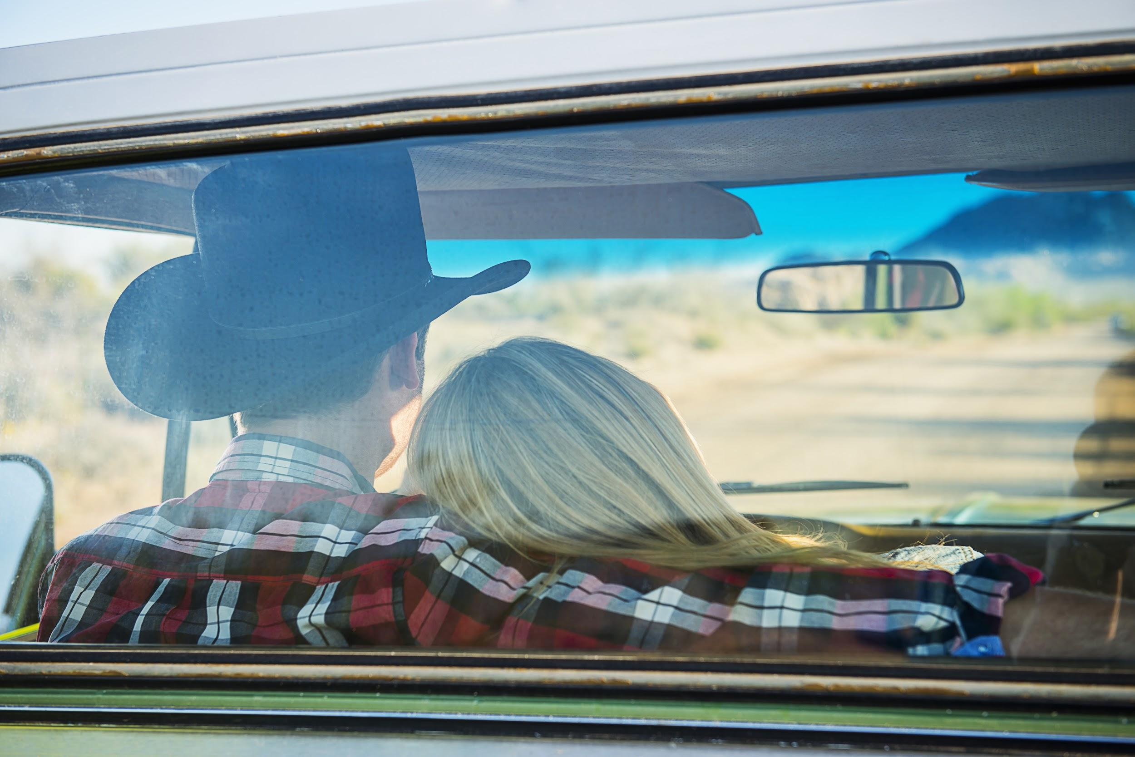
OUR USERS WANT:
Intuitive and easy to use
Good results the first time
Well laid out pages or display
Want minimal but helpful information about the books: title, author, description
To be able to use effectively and efficiently

